Slide 1
Greek-American Women’s Writing in the First Half of the Twentieth Century
By Theodora D. Patrona, Ph.D.
2012 -2013 Library Research Fellowship
Tsakopoulos Hellenic Collection
California State University, Sacramento
Funded by the Elios Society

Slide 2
Women’s clubs in America as seen by Maria Sarantopoulou-Economidou in 1916.

Slide 3
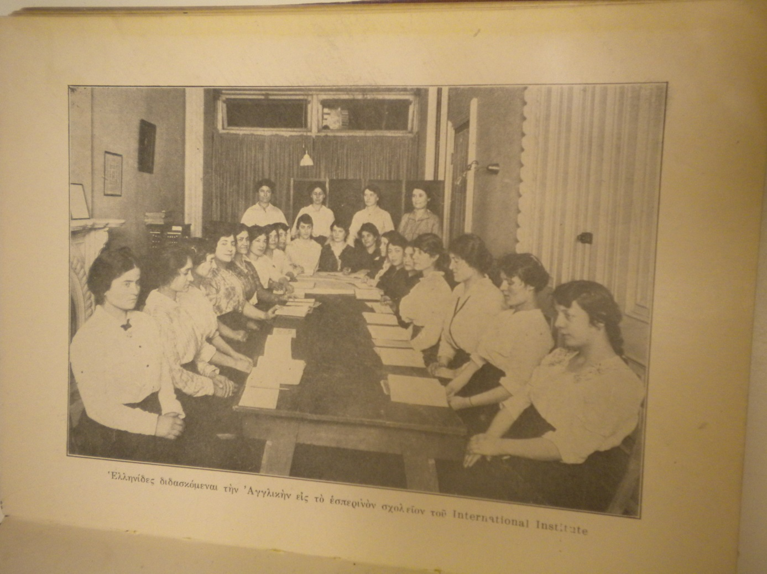
Greek immigrant women learning English in America (Sarantopoulou-Economidou 1916).

Slide 4
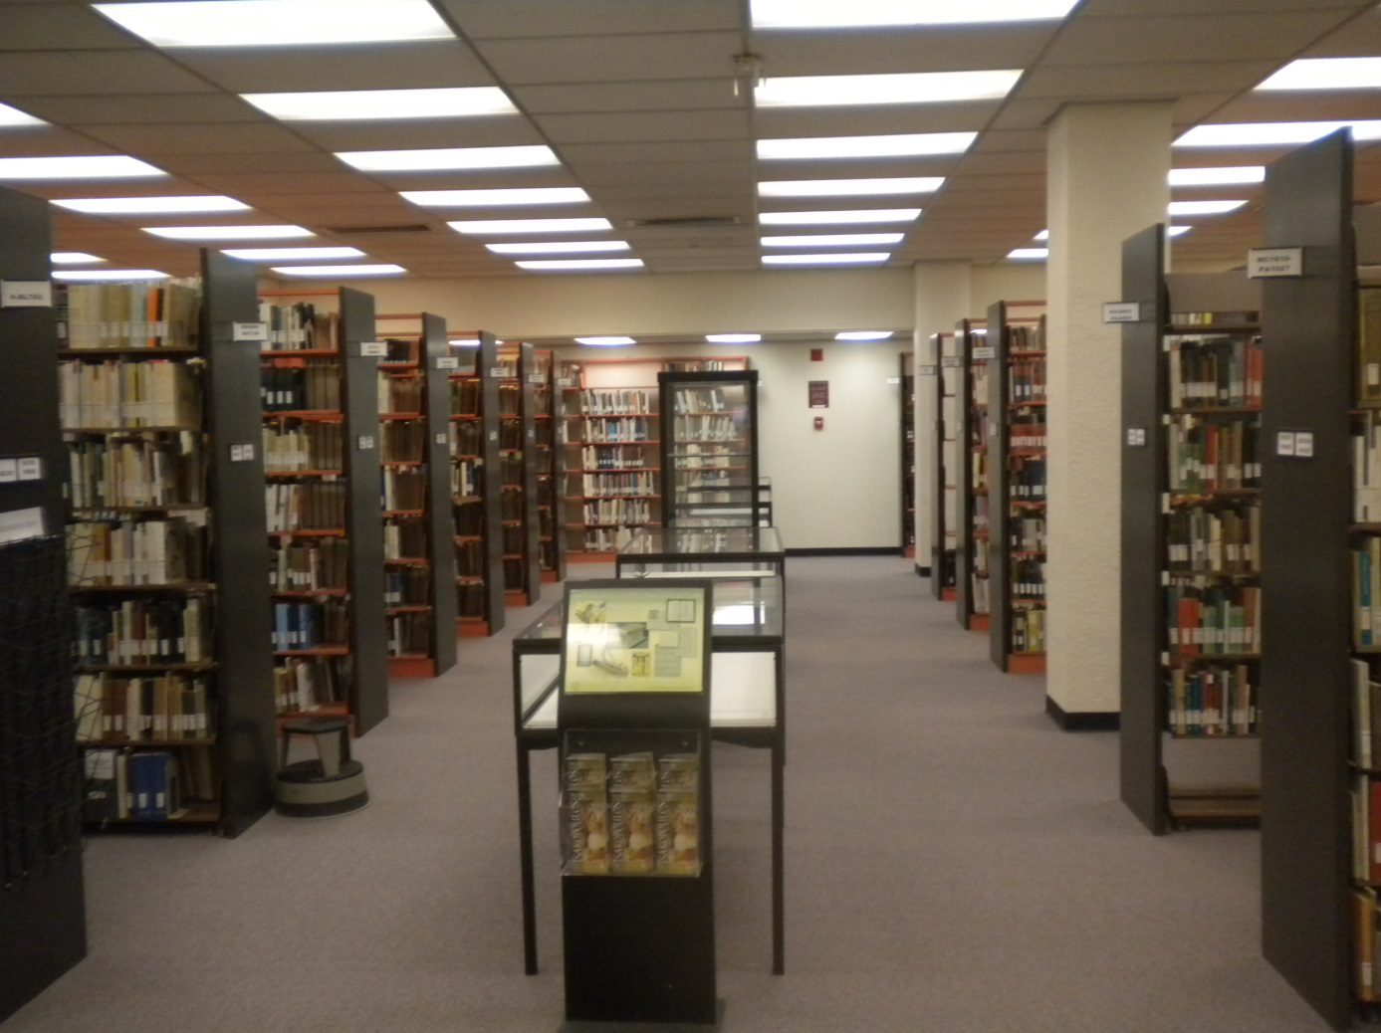
The Tsakopoulos Hellenic Collection
at California State University, Sacramento.

Slide 5
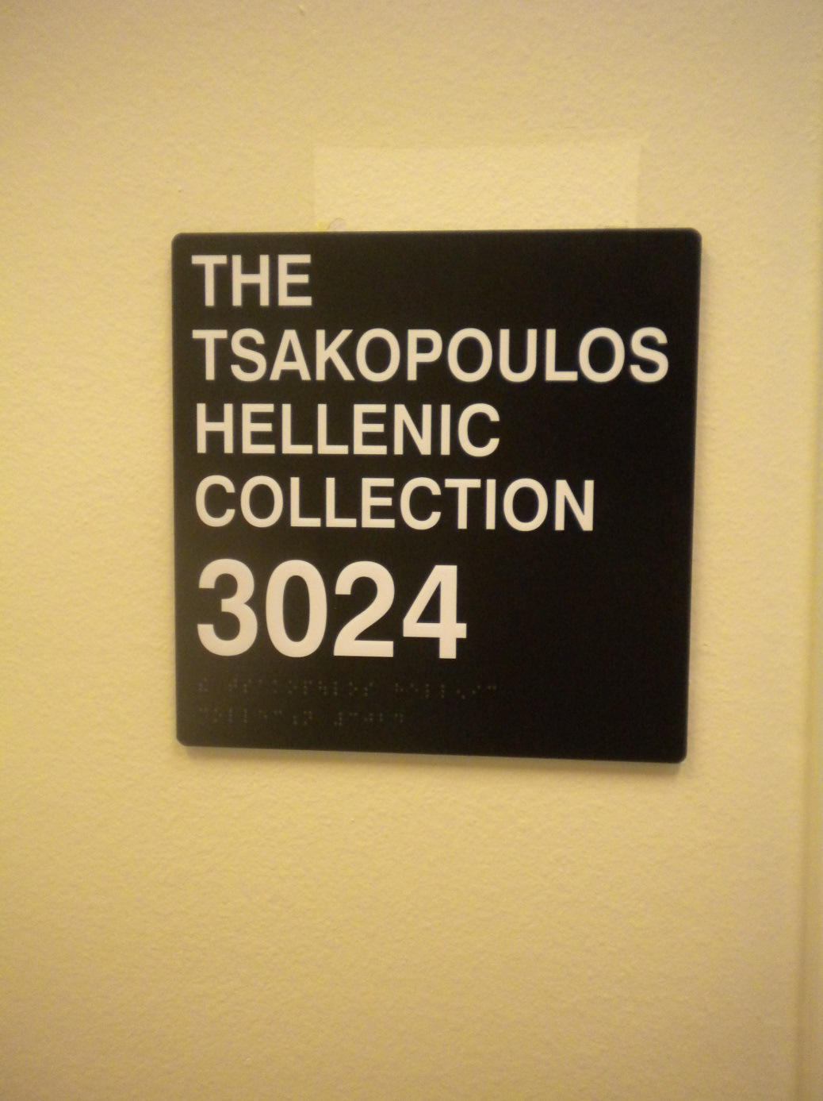

Slide 6
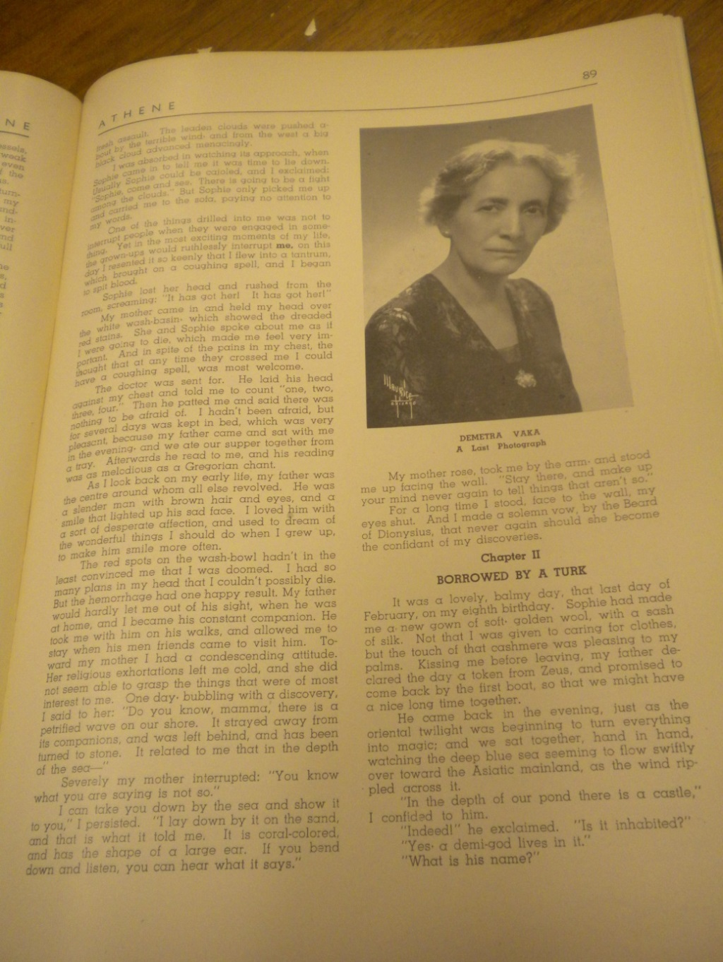
Demetra Vaka-Brown, one of the few Greek women writers studied as early as the 1940s.

Slide 7
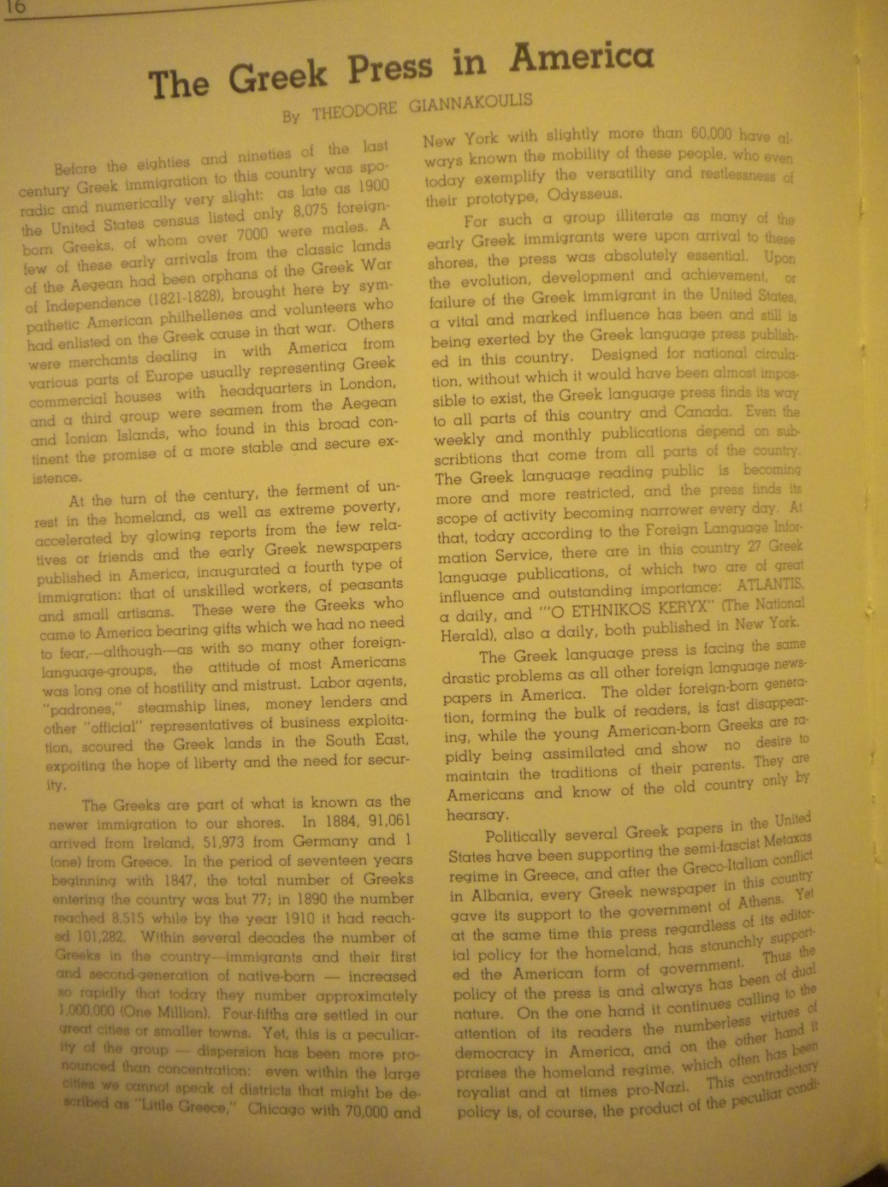
One of the early 1940s Athene articles on the Greek immigrant press where women authors tried their writing powers.

Slide 8
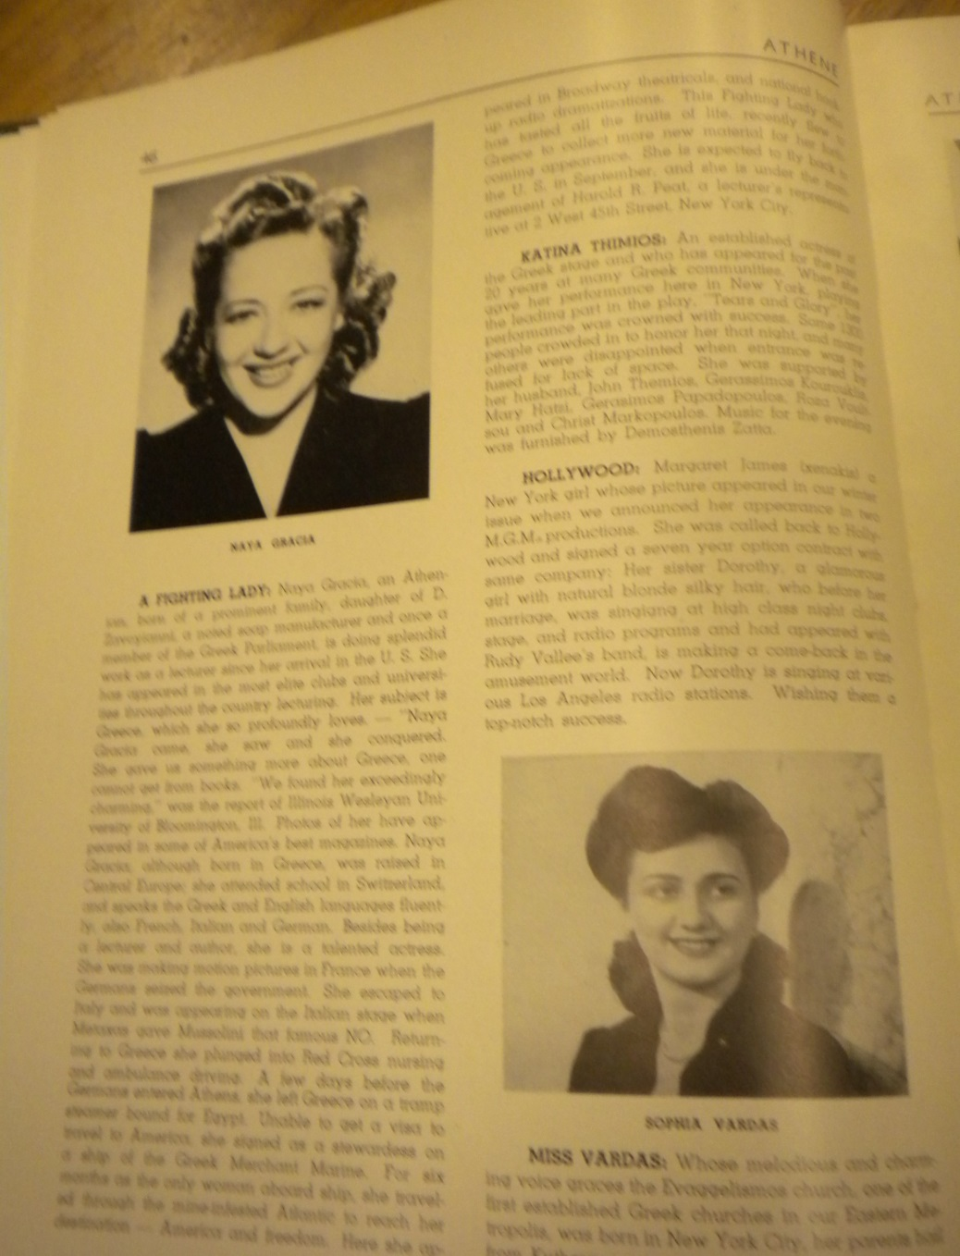
An 1940s Athene article on Greek women’s activities in the performative arts.

Slide 9
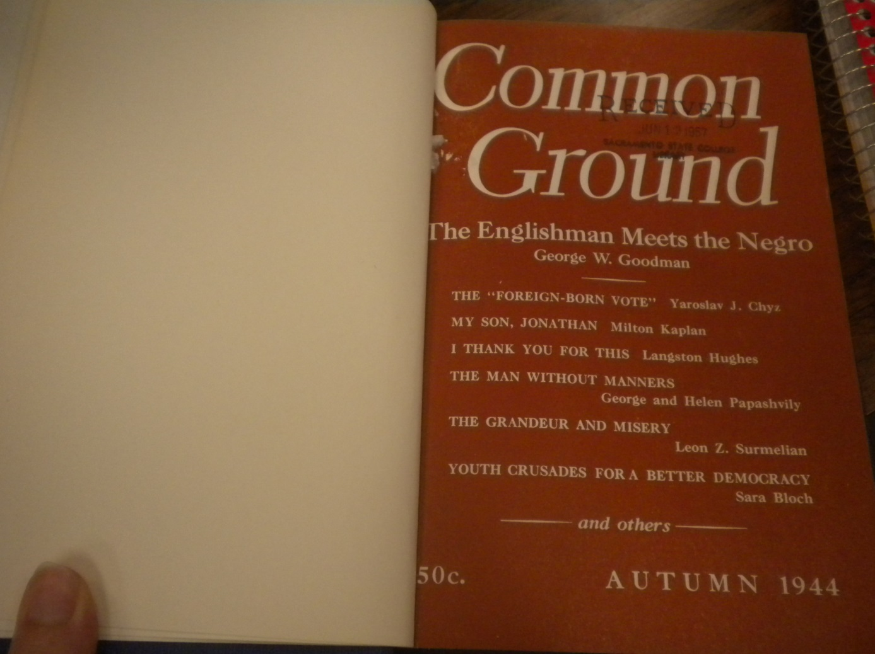
One of the rare periodicals with Greek women’s short stories, found through rare bibliographies.

Slide 10
One of the two earliest copies of Athene, dating from the summer of 1941.

Slide 11
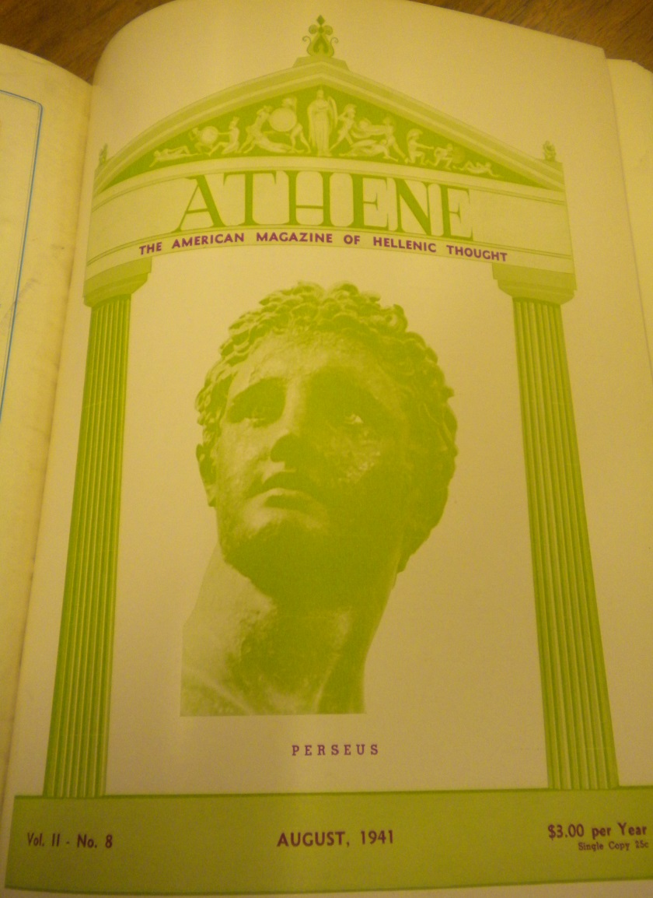
The front cover of the Athene August 1941 issue.

Slide 12
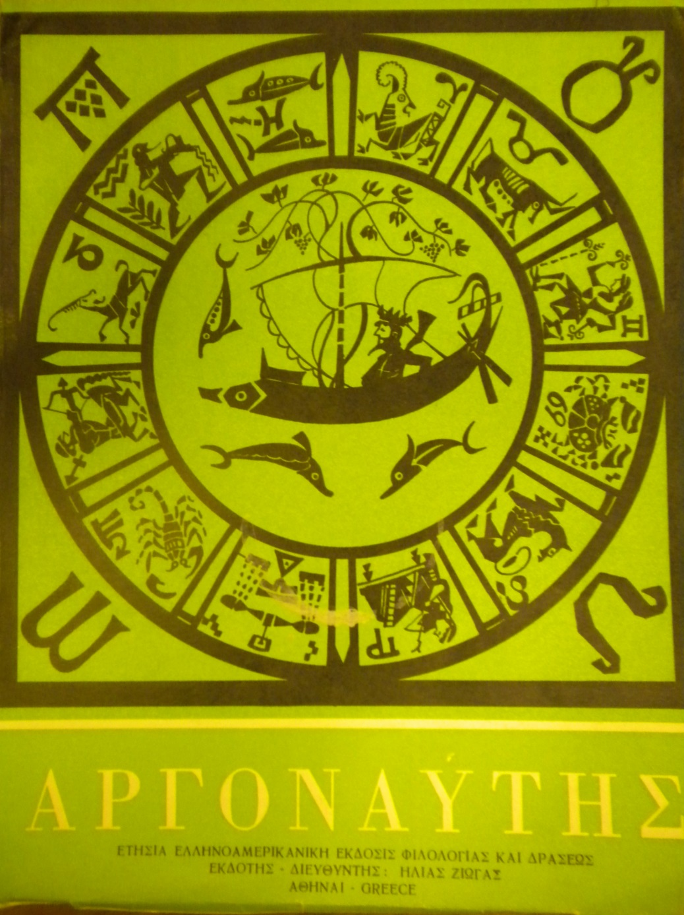
Argonautis, an important source of literary information.

Slide 13
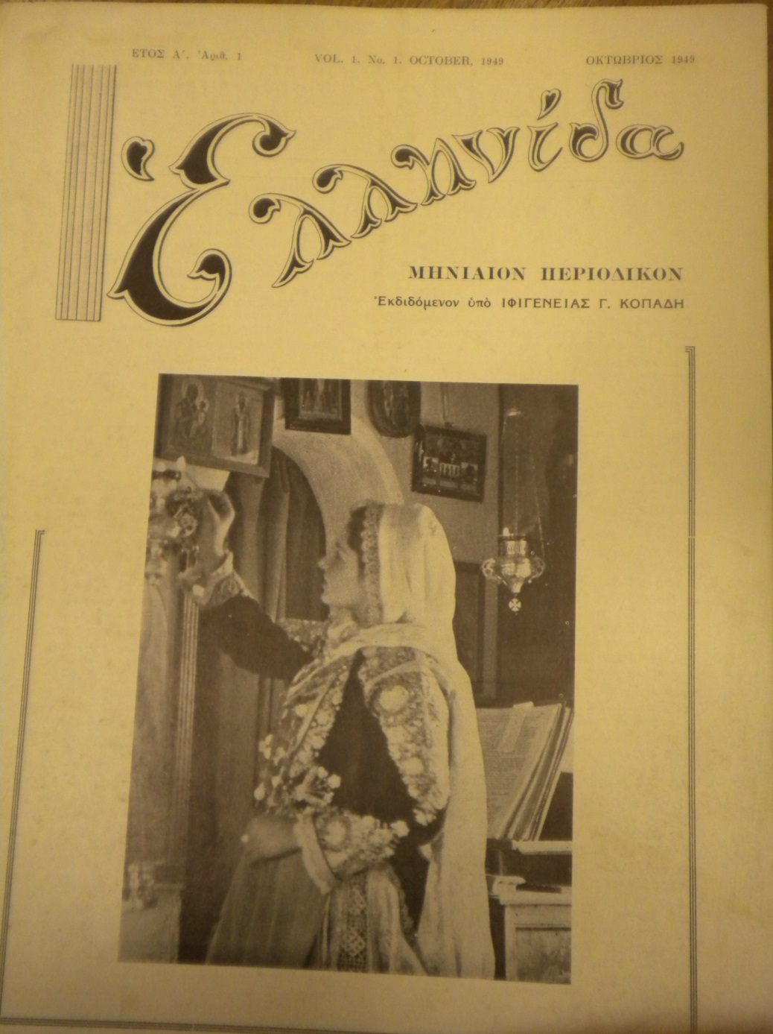
Ifigeneia Copadis’s Women’s Magazine Ellenitha from 1949.

Slide 14
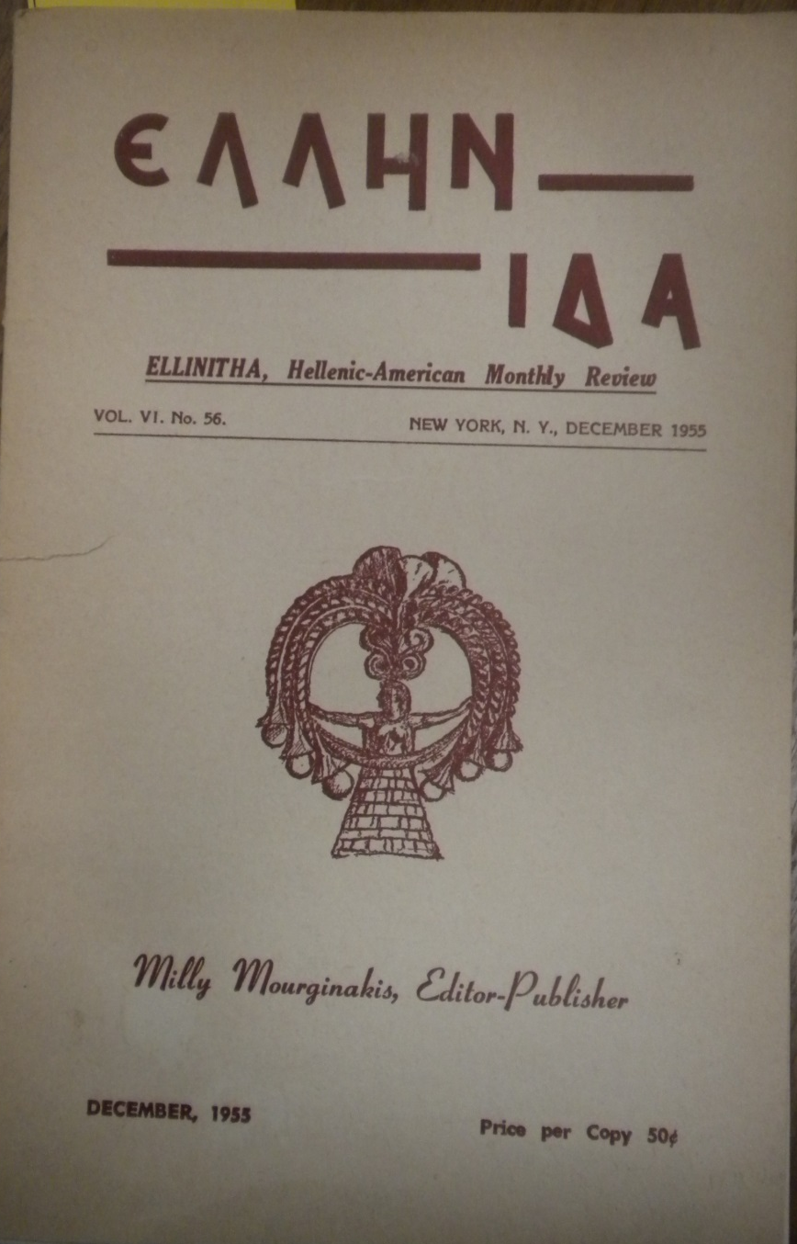
The sell-out of Ellenitha and the name change to Ellen-Ellenitha in 1955.

Slide 15
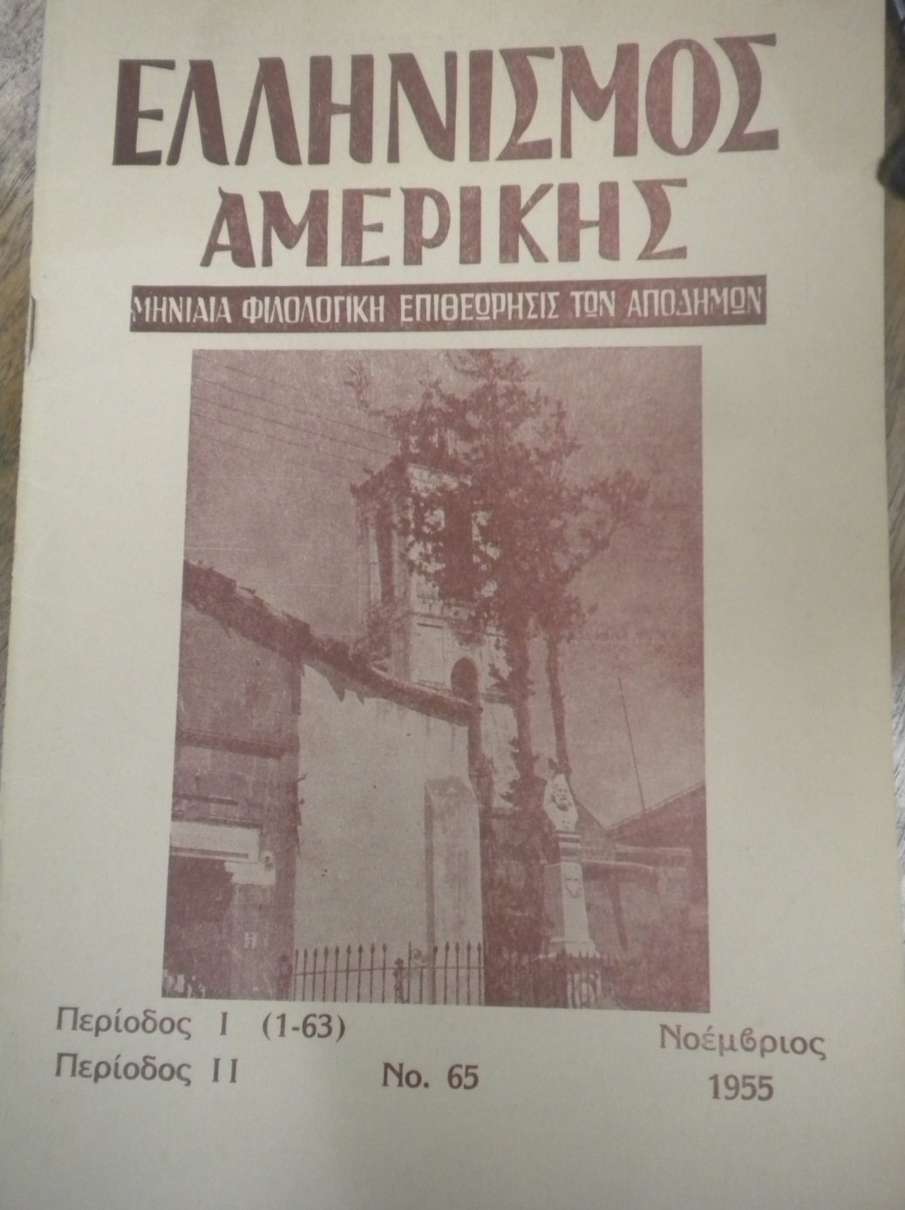
The final name change to Ellenismos tes Amerikes.

Slide 16
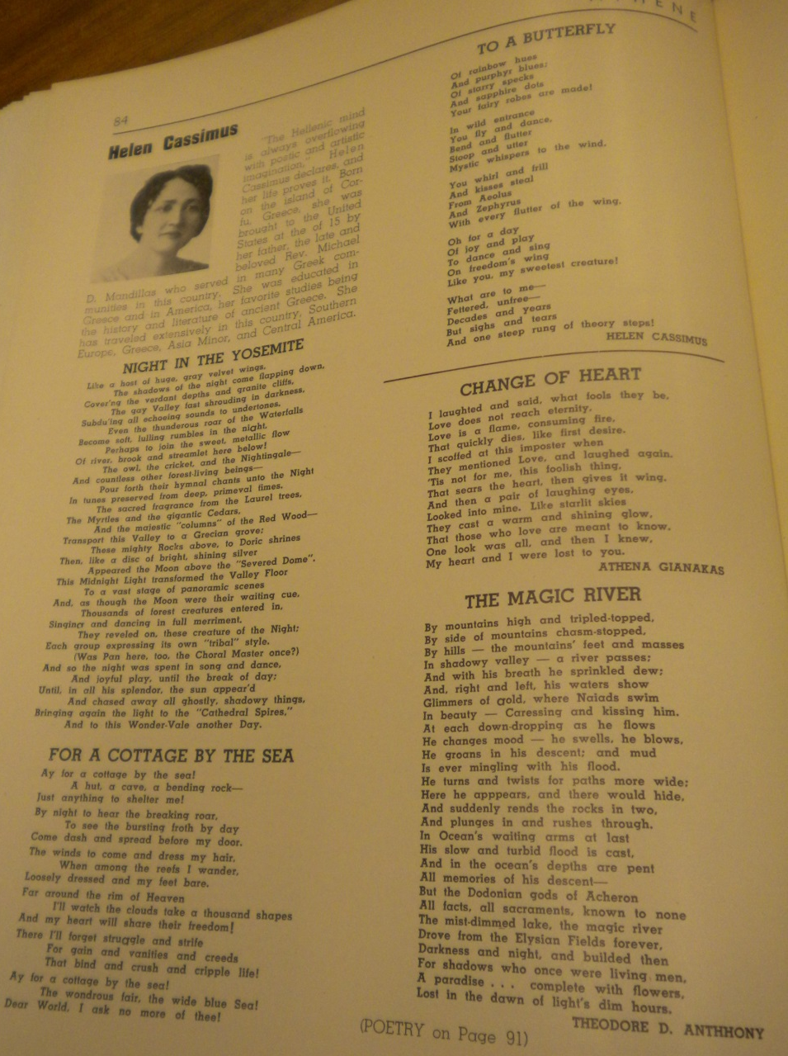
Among others, Helen Cosimus and Athena Giannakas contributed their poems to Athene.

Slide 17
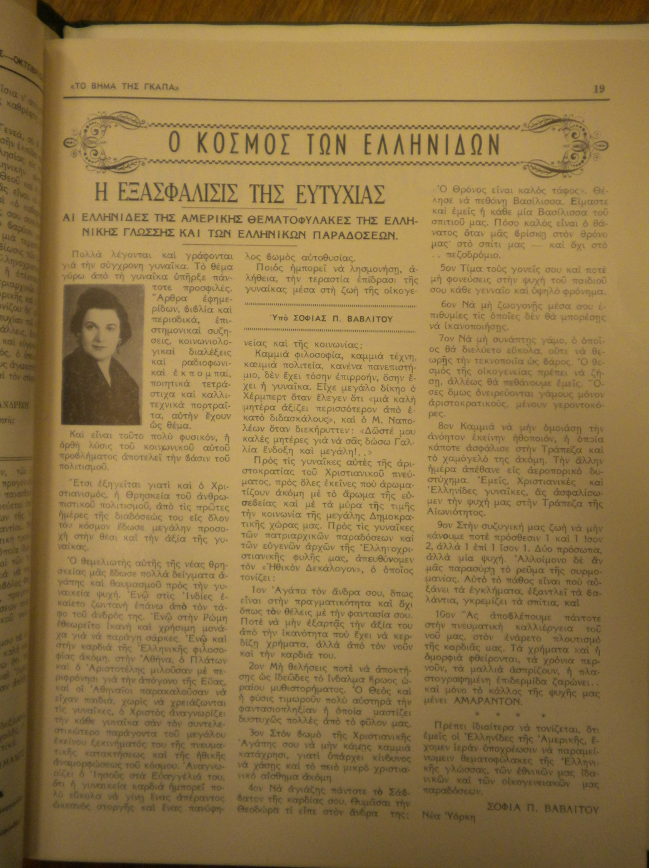
Women like Sofia Vavlitou regularly published their work in periodicals like To Vema tes Gapa.

Slide 18
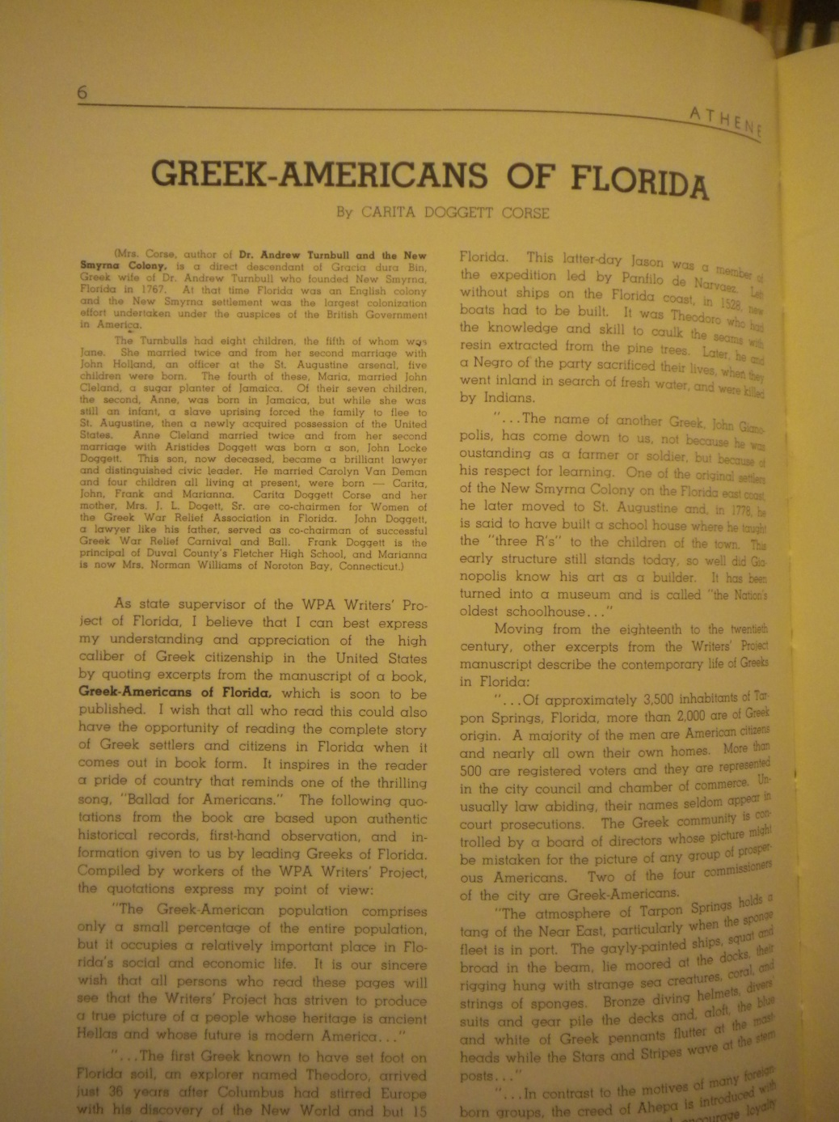
Carita Dogget Corse’s article on the Greek-American presence in Florida and her ancestor’s, Dr.Andrew Turnbull’s, role.

Slide 19
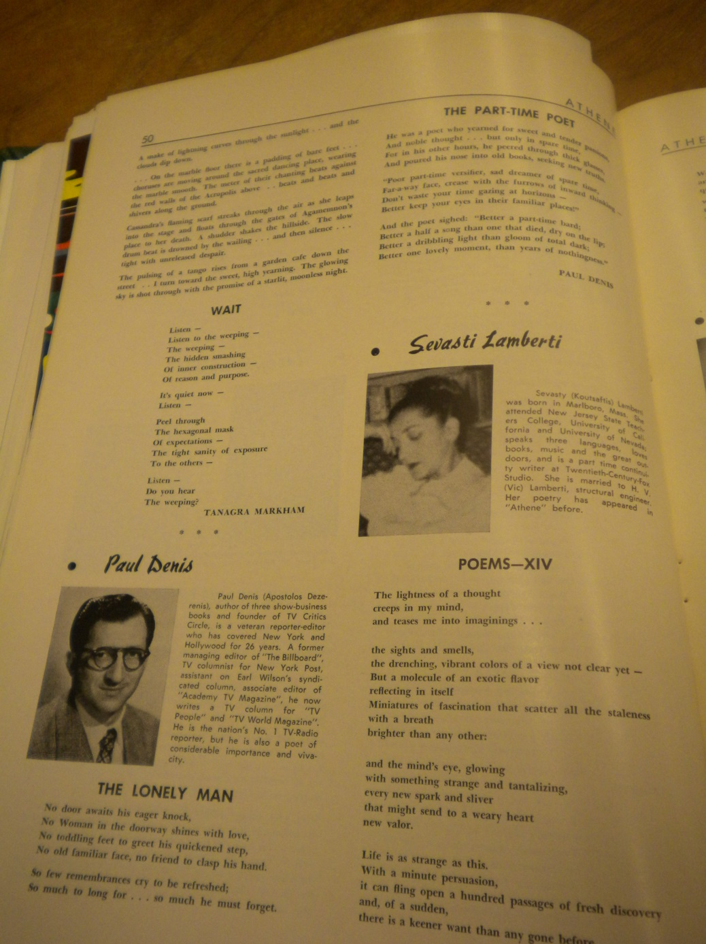
Unlike early in the century, Greek women in the 1940s did not hesitate to include their names with submissions.

Slide 20
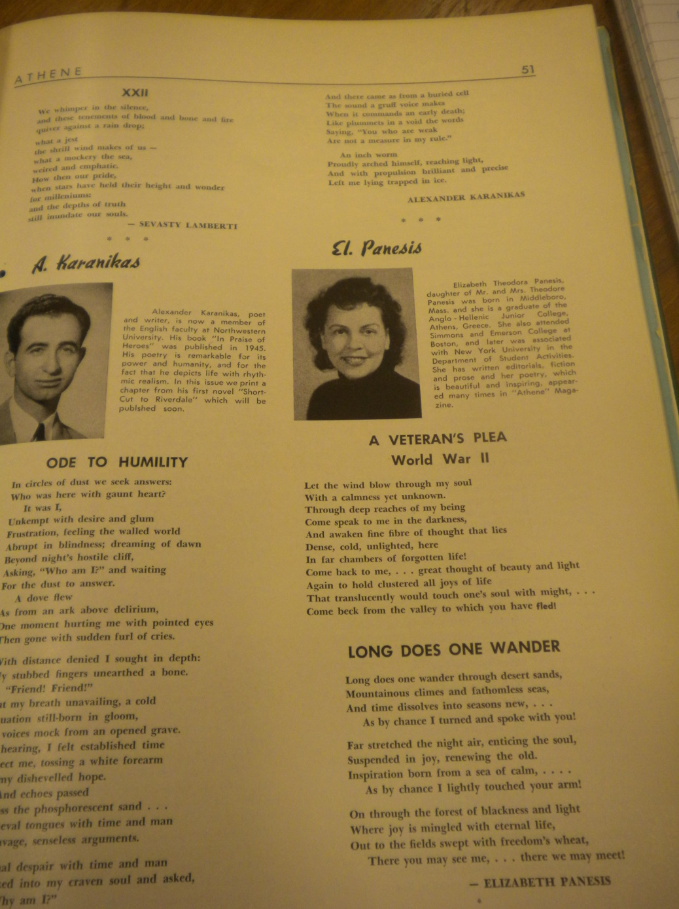
Though local ethnic histories fail to acknowledge them, Greek women writers came from diverse states.

Slide 21
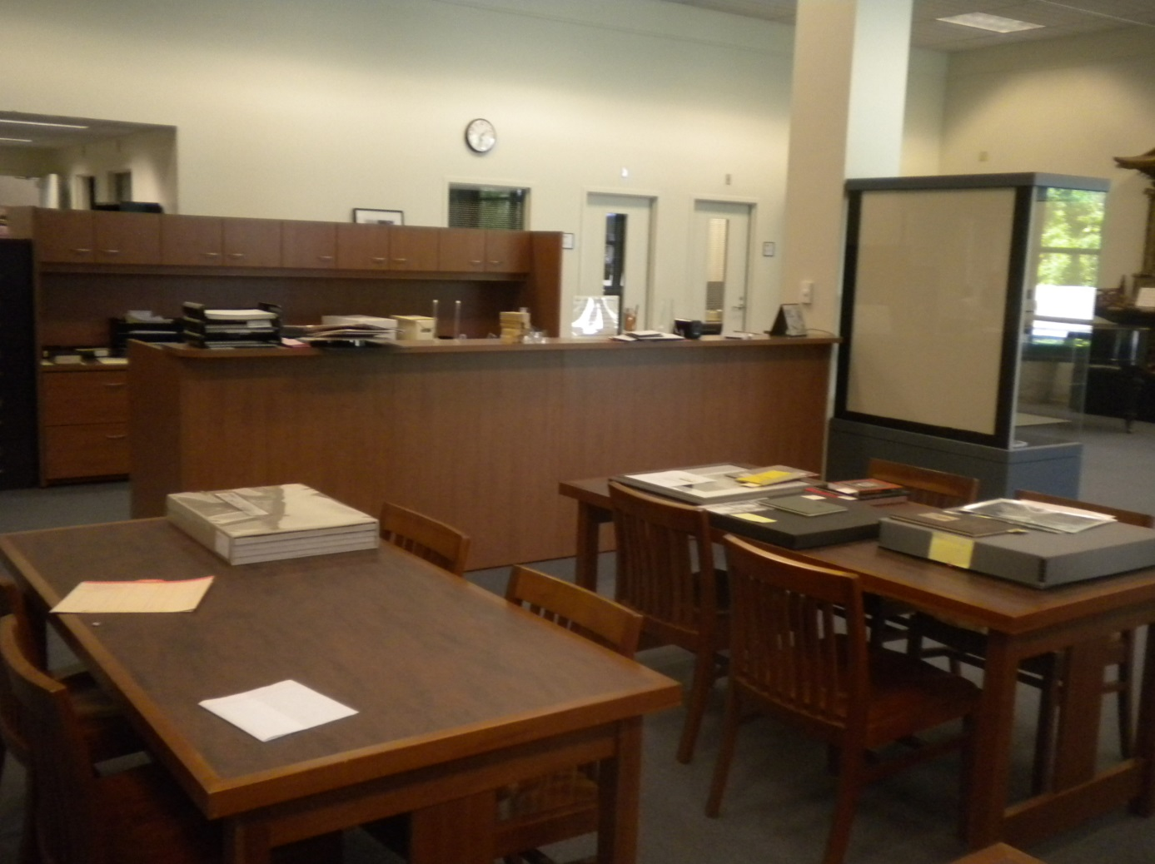
Special Collections and University Archives California State University, Sacramento.

Slide 22
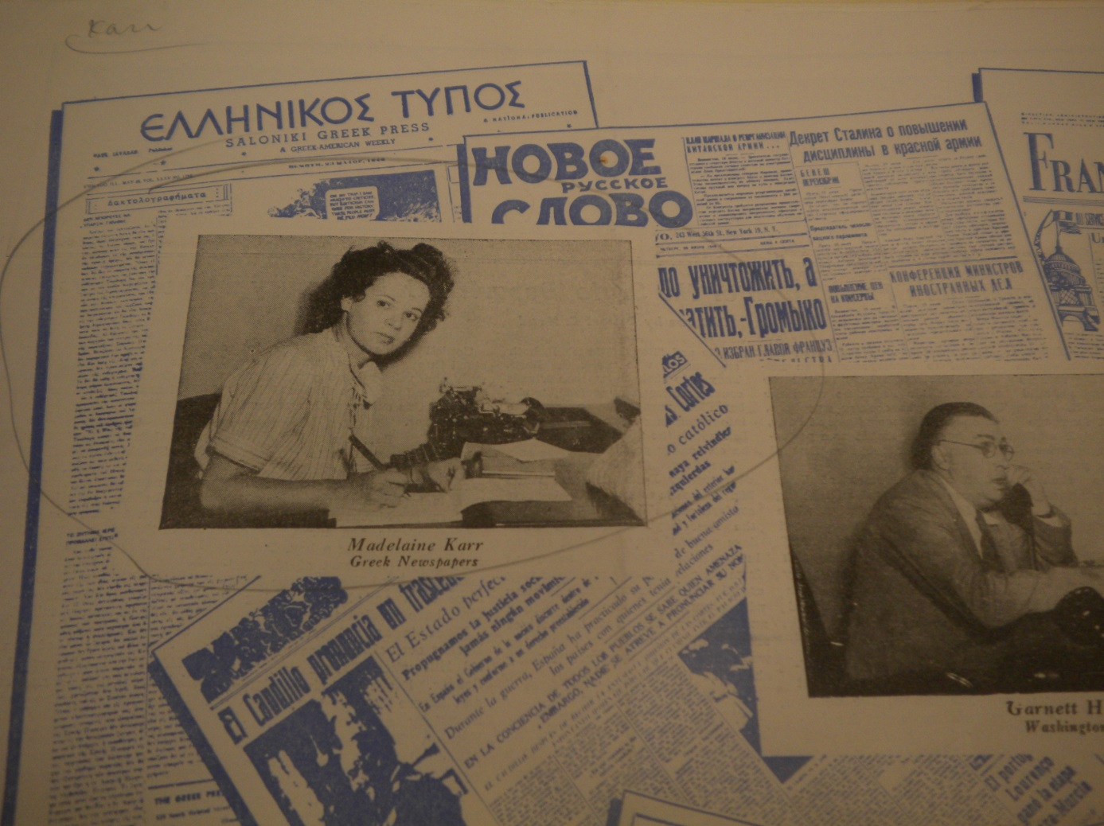
Women Journalists: Madeline Karr and the National Herald.

Slide 23
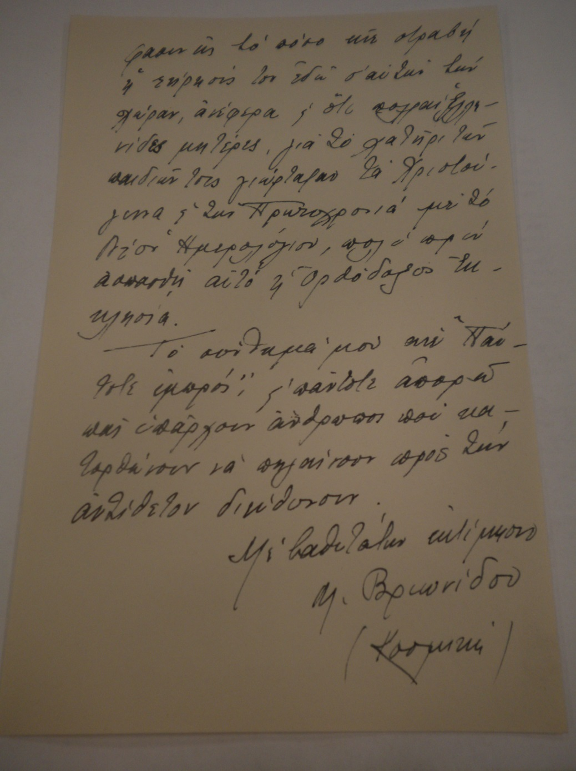
Mary Vrionides’s Letter to Basil Vlavianos.

Slide 24
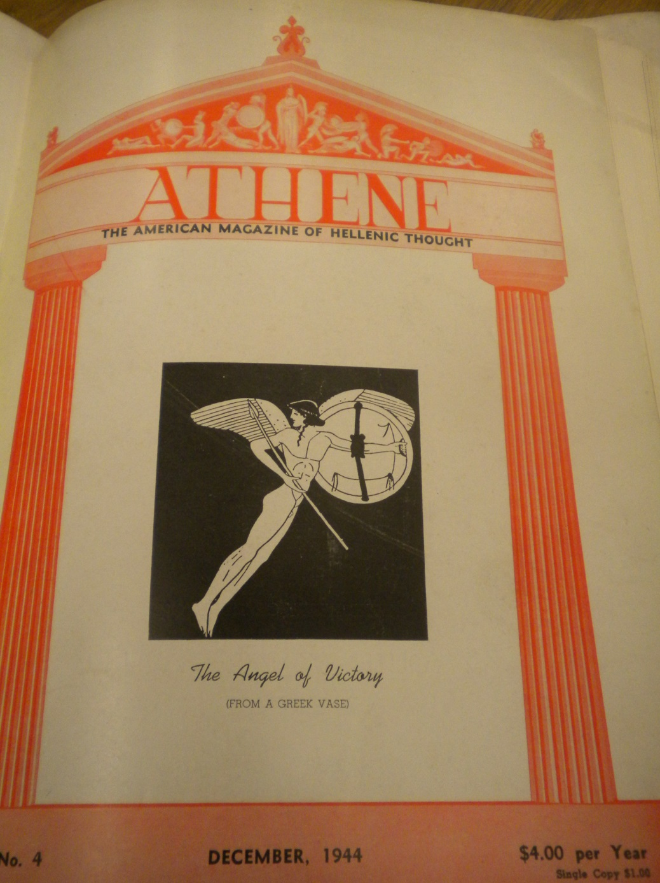
Women’s publications in Athene appeared as early as 1944.

Slide 25
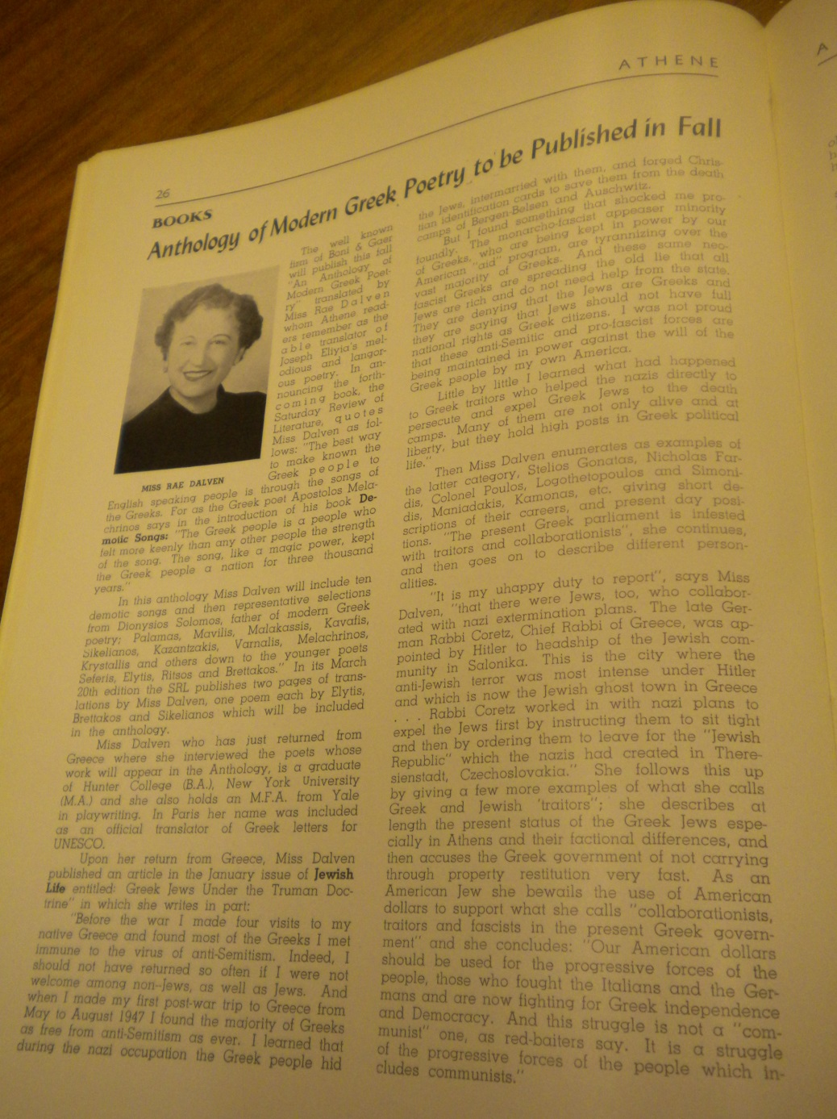
Article on Rae Dalven’s important work on Greek Literary Translation.

Slide 26
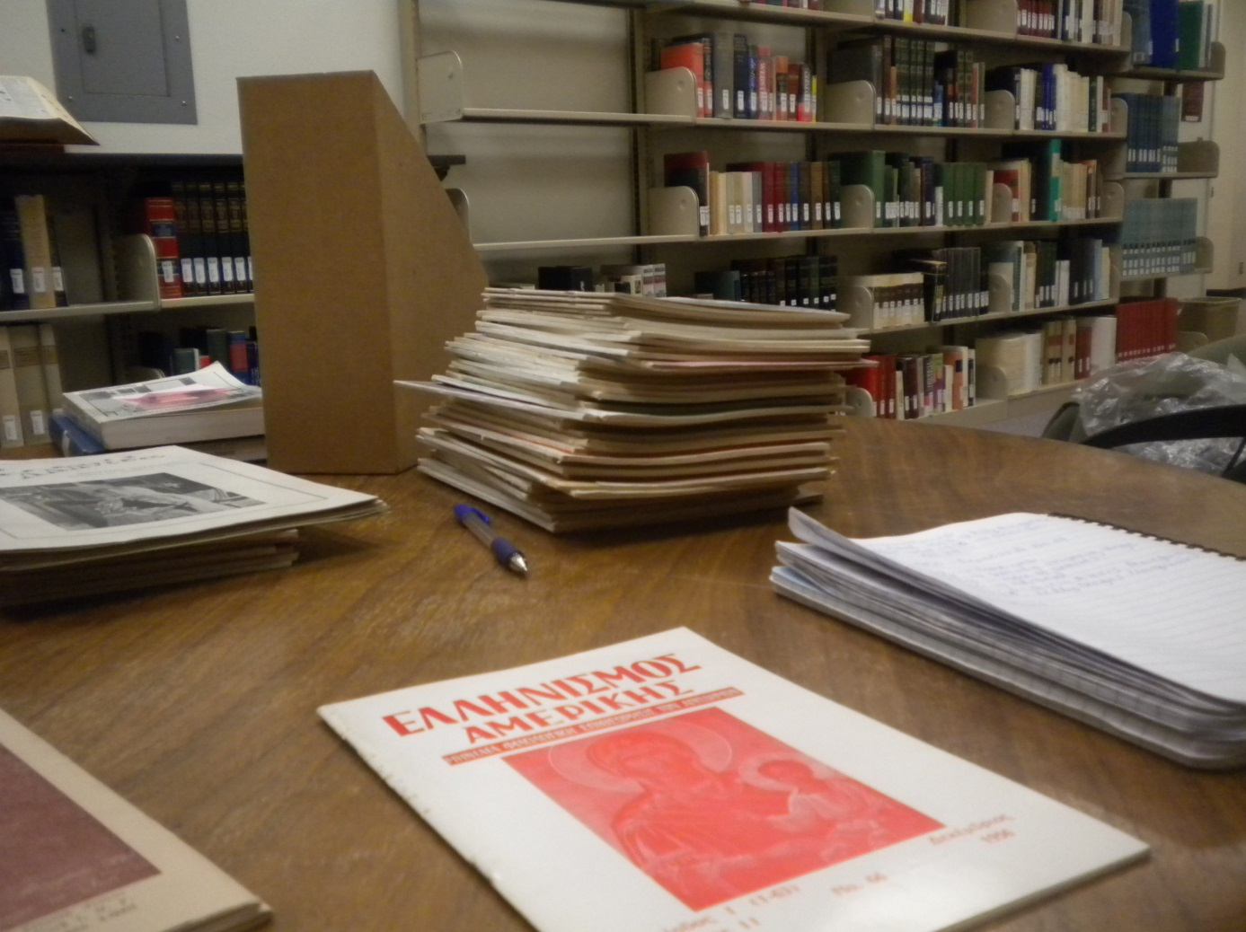
Greek Women writers and the ambitious book-length project.

Slide 27
Works Cited
Saloutos, Theodoros. The Greeks in America: A Student’s Guide to Localised History. Cambridge: Harvard University Press, 1964.
Xenides, J.P. The Greeks in America. New York: Henry H. Doran Company: 1922.
Ziogas, Elias. To Kykneion Asma ton Hellenoamerikanekon Grammaton. Athenai:1978.

